Slide 1



Measurement Assumptions
Dr Oliver Clark

Slide 2
Last Week
Constructs – what are we measuring?
Measurement Paradigms – What do we mean by measurement
Dimensionality – Are we measuring only one ‘thing’
Notes:
Last week we established that our measure was (or was not) unidimensional. I mentioned that this is a major assumption for the statistics that follow. Before we go any further with calculating our sum scores, a consideration of the other assumptions is required.

Slide 3
This Week
General Linear Model makes assumptions about our data…
The models we use in measurement have assumptions
Not discussed often
Can mess up our inferences
Notes:
When we do any analysis using the general linear model, we make assumptions about or data – such as equal variances (so each group has the same standard deviation), and continuous, normally distributed data. We have a toolbox of tests to check our data to see if these are met; we have Mauchley’s test, we have Levene’s test, etc.
Firstly [click], our measurement models also come with their own assumptions; secondly [click] they are not often covered in introductory textbooks, and thirdly [click] not meeting them they can mess up our inferences.
We’re first going to look at three different models of reliability, and then the assumptions that we need to make to use either.

Slide 4
Assumptions
Unidimensionality
Normally distributed errors
Notes:
First of all, we’ll cross out Unidimensionality because we have looked at it, and it is common to all of the following models

Slide 5
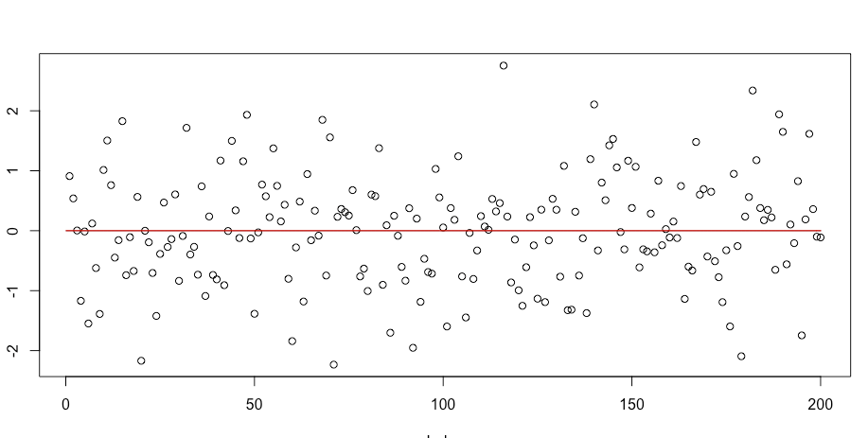
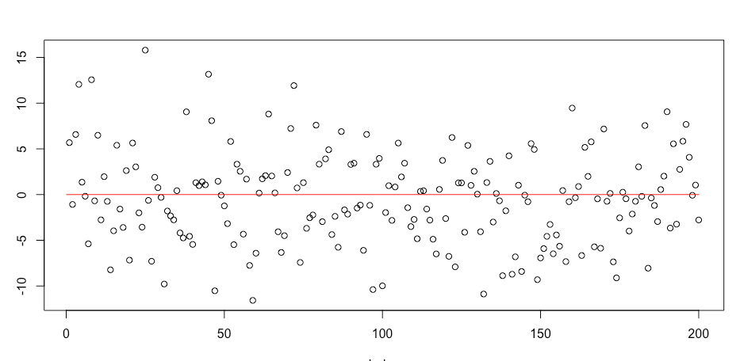
Quick Glossary
Variance
The degree to which the data points are spread out from the mean
Square of the standard deviation
Larger variance = larger average distance from the mean
Variance = 1
Mean = 0
Variance = 25

Slide 6
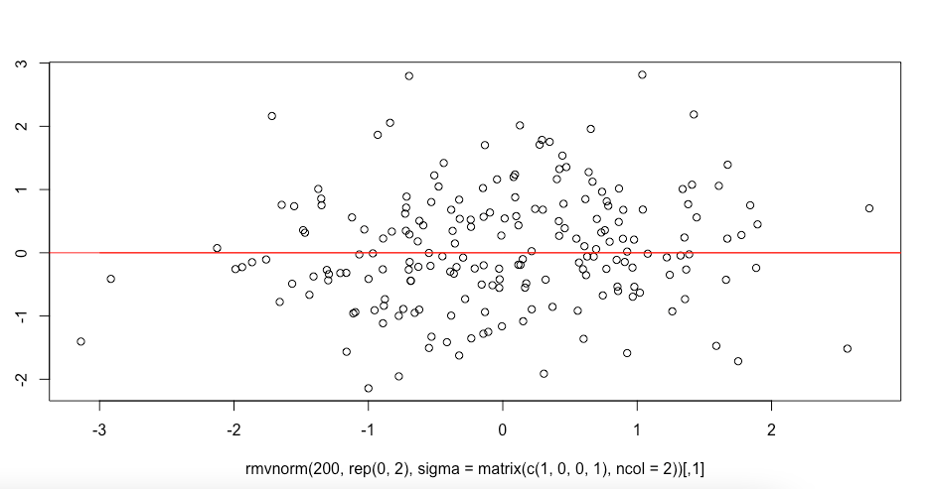
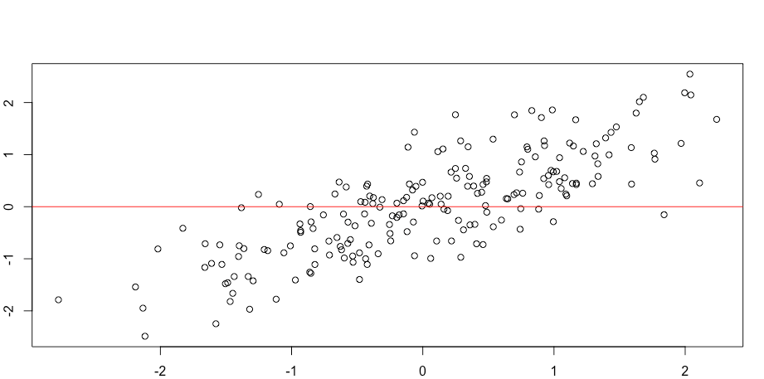
Quick Glossary
Covariance
If the variation in two variables changes in parallel
Correlation = 0
Mean = 0
Correlation = 0.8

Slide 7
Procedure
Item Assumptions
Reliability
Sum/Mean score

Slide 8


Parallel Reliability
All items measure the same thing identically
The Parallel Multi-Linguist Cat-Lovers Scale:
Do you like cats?
¿Te gustan los gatos?
Aimes-tu les chats?
ل تحب القطط
I used google translate….

Slide 9
Parallel Reliability
 | Item 1 | Item 2 | Item 3
Item 1 | 2 | 5 | 5
Item 2 | 5 | 2 | 5
Item 3 | 5 | 5 | 2
Co-variances
Variances
Notes:
The variances and covariances would look like for such a measure – Each item has the same variance, and is related to all other items identically. I would be very surprised if you ever come across a measure that meets these requirements – it’s kind of an idealized form of reliability, something that psychometricians may strive towards but never achieve!

Slide 10
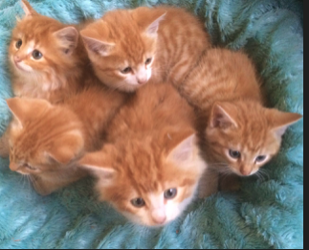

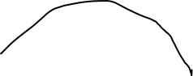
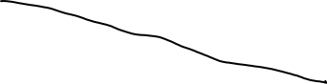
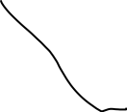
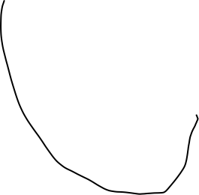
Tau Equivalent Reliability
Tau-Equivalent Cat-Lovers Scale
Do you like this one
Notes:
Tau Equivalent reliability is slightly more lenient than parallel models of reliability. It assumes that covariances between items are the same, but each item’s variance is free to vary. There is also something called Essential Tau Equivalence which makes the assumption that all items have the same true score. Another way to put this is rather than assuming all items are ostensibly IDENTICAL like in parallel analysis, you have a little more freedom to explore you construct. [Click] Here we are asking questions about several different cats, but they are all similar enough that liking them would not vary too much between questions.
The Tau Equivalent is the most commonly used model, but as you will see in the readings, many measures cannot live up to the assumptions. Cronbach’s alpha is also known as Tau Equivalent Reliability, and should only be used if the item scores for each item ought to be the same.

Slide 11
Tau Equivalent Reliability
 | Item 1 | Item 2 | Item 3
Item 1 | 3 | 5 | 5
Item 2 | 5 | 4 | 5
Item 3 | 5 | 5 | 2
Co-variances
Variances
Notes:
So under Tau equivalence our variances within items are free to change, but we still assume that each item correlates to the same degree with other items.

Slide 12
Essential Tau Equivalent Reliability
 | Item 1 | Item 2 | Item 3
S1 | 2 | 3 | 1
S2 | 5 | 5 | 6
S3 | 5 | 4 | 5
Item Mean | 4 | 4 | 4
Notes:
So here we have a set of scores for three people, and the columns have the same mean. Needless to say you can have some variation in these scores due to measurement error, but they should be very similar to meet this assumption.

Slide 13




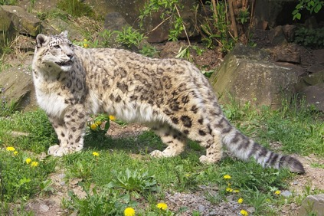
Congeneric Reliability
Do you like these?

Slide 14
Three Reliability Models
Parallel
(Essential) Tau Equivalent
Congeneric

